Slide 2
Interestingness Of Patterns
The interestingness of patterns can be viewed from 2 point of views that is subjective and objective interestingness.
The subjective Interestingness can be explained as a pattern can be interesting to a person while for an another person it is not.
The objective interestingness can be explained simply the mathematical measure of interestingness of a patter or in more simpler terms , an statistical approach to measure the interestingness of a patter.
As we cannot surely determine the subjective interestingness , we will look into the objective interestingness of the pattern.

Slide 3
Statement :Some of the strong association rules can be misleading .
Proof :
Consider a total transactions as 10000, out of which 6000 are t’s that include cricket bats, while 7500 of t’s include cricket balls,4000 t’s include both.
{min _support=30%,min_conf_threshold=60%}
Buys(x,”cricket bat”)-------→buys(x,”cricket ball”)
Calculate if this is a strong association rule or not .
Certainly , we shall calculate the support and confidence of this rules , that is 40% and 66%.
As this rule satisfies the min_support and conf_threshold , this is said to be strong association rule.

Slide 4
If you see this rule says on the total ,40% of people had bought both together and a person who buys a bat tends 66% to buy a ball.
But if you see balls alone comprise 75% of the transactions, so there is not point in relating a rule with 66% confidence, so here we need measures like lift and chi-square to find out the correlation between the data .

Slide 5
Lift: support(bat U ball)/support (bat)*support(ball)
A lift value greater than 1 indicates a positive correlation, meaning the items appear together more often than expected by chance. A lift value less than 1 suggests a negative correlation, indicating the items appear together less often than expected.
Lift for the above example can be =0.40/0.60*0.75=0.89.
Even though having a strong association rule between them we can now notice that there is negative correlation between them.

Slide 6

Chi-Square:
This measure is also used to find out the relation between the the data , for this we need to use a contingency table , which looks like this .
For calculating the chi-square measure there are two values that we need to keep in mind ,expected and observed.
Expected value of A and B=
Occurrences of A*Occurrences of B/
Total number of t’s
χ 2 =
χ 2 value is greater than 1, and the observed value of the slot (bat, ball) = 4000, which is less than the expected value of 4500, buying game and buying video are negatively correlated.
 | Cricket_bat | -cricket bat | Sum_of _row
Cricket_ball | 4000(4500) | 3500(3000) | 7500
-cricket_ball | 2000(1500) | 500(1000) | 2500
Sum_of_col | 6000 | 4000 | 10000

Slide 7
But there are some scenarios where we can consider some other the data set is very large and there are many null transactions.
Now what does null transactions mean?
If the data set is large and the support count and conf threshold is low ,we have found out the lift and chi –square are effective , is this true in all cases ?
No in some of the cases where there are more null transactions , it is observed that the measures of lift and chi sqare are often misleading.

Slide 8
So some people have proposed some other methods whose measure if not dependent on the null transactions.
Those are allconf , jaccard, cosine,kulzynski,maxconf.
All these measure do not give a misleading measure even though if there are many null transactions.

Slide 9
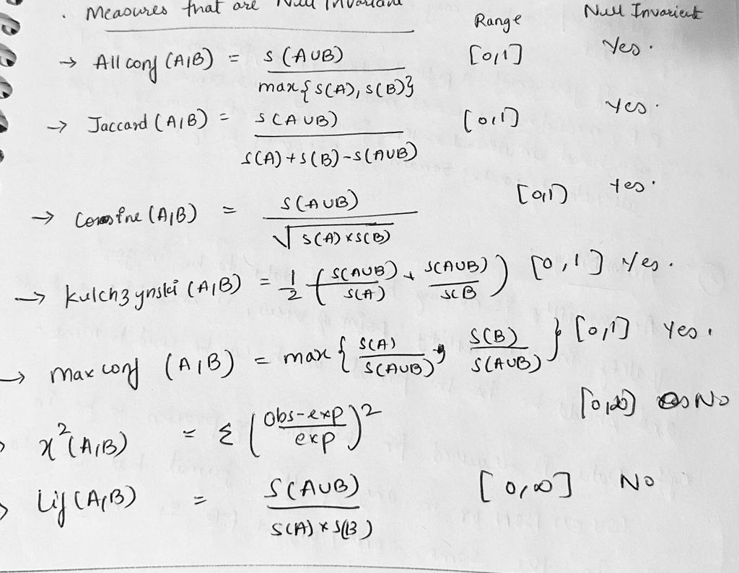
Overview of all the measures.

Slide 10
